Slide 1
Big Horn Basin Regional Dialysis Center
2017 Purpose Project

Slide 2
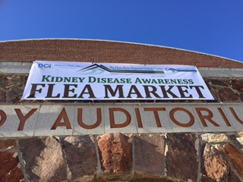
Kidney Disease Awareness Flea Market
June 10, 2017 10 am – 3 pm

Slide 3
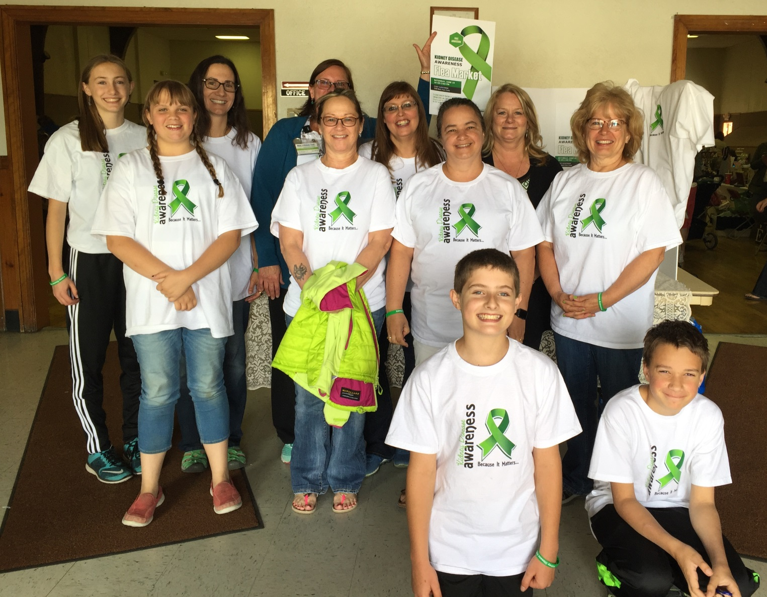

Slide 4
Purpose of Event
Big Horn Dialysis wanted to hold an event that educated the community about Chronic Kidney Disease which included the importance of early detection, interventions that could be taken to keep the kidneys healthy and what resources are available in the community to help if you are a chronic kidney disease patient.

Slide 5
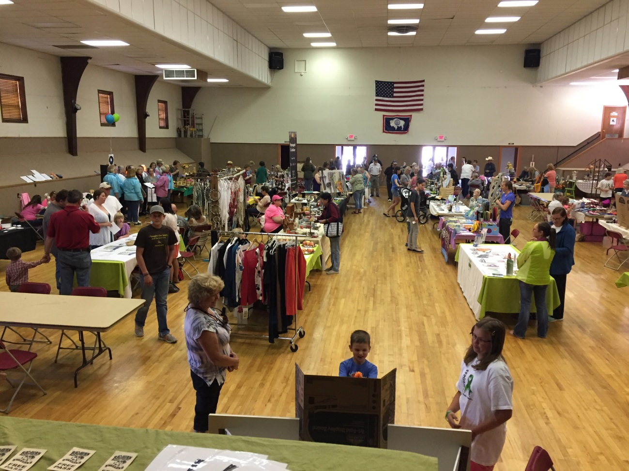
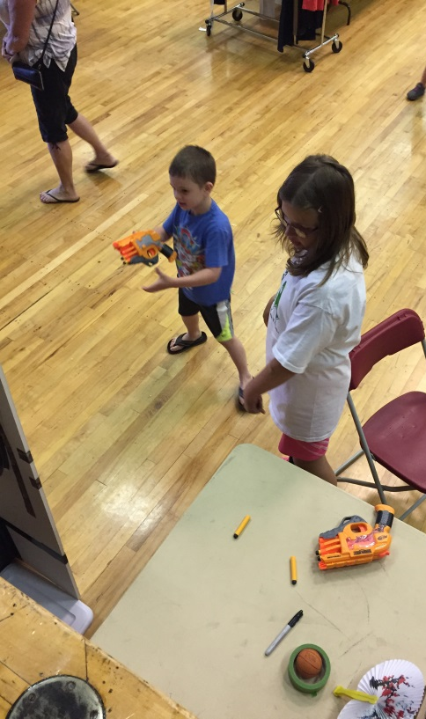
Having fun with a splash of education!!
Flea Market Venders
Games for Kids!!

Slide 6
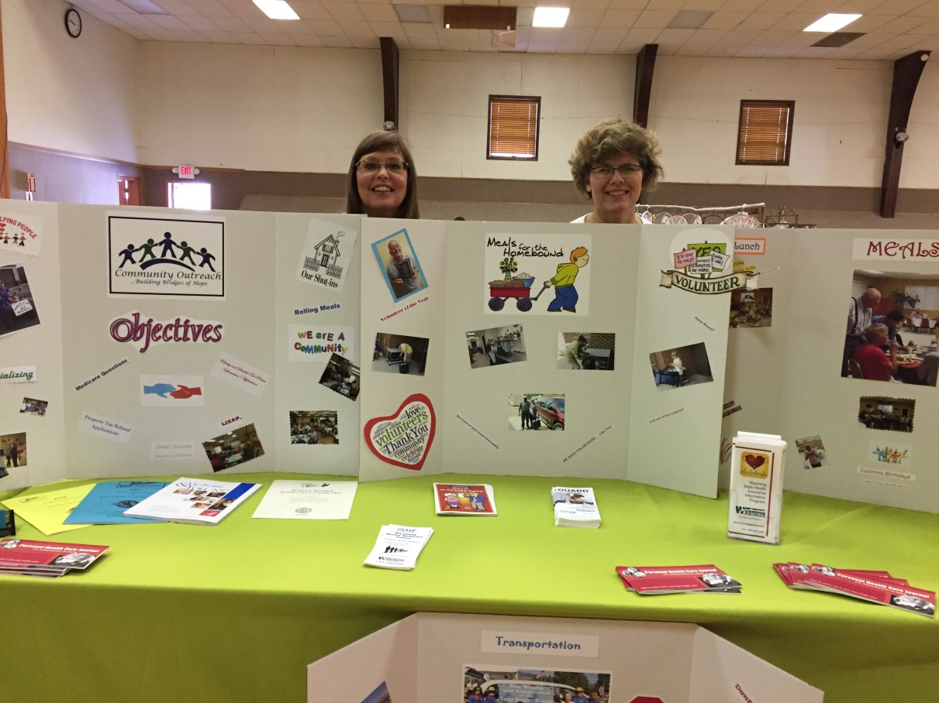
Community Education #1
Cody Senior Center
“Resources in our community”

Slide 7
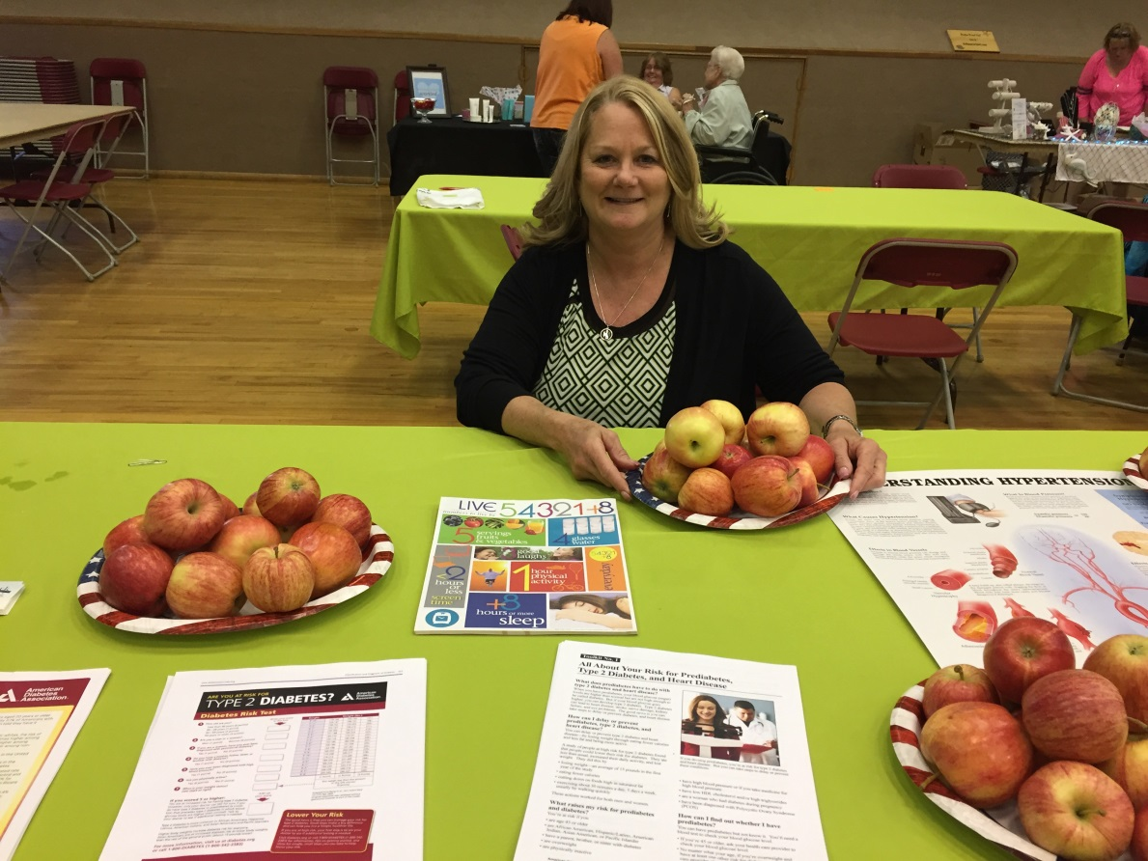
Community Education #2
Liz Fabrizio, Ms, RDN,CDE, LD, BC-ADM
“Eating well/kidney disease prevention”

Slide 8
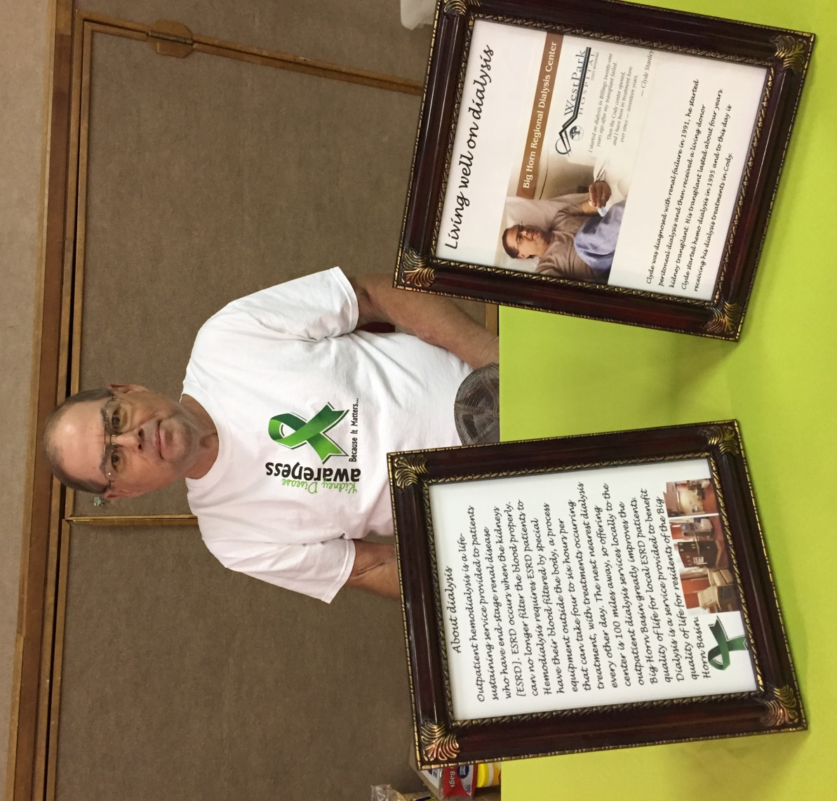
Community Education #3
Clyde, patient at Big Horn Dialysis
“Living Well on Dialysis”

Slide 9
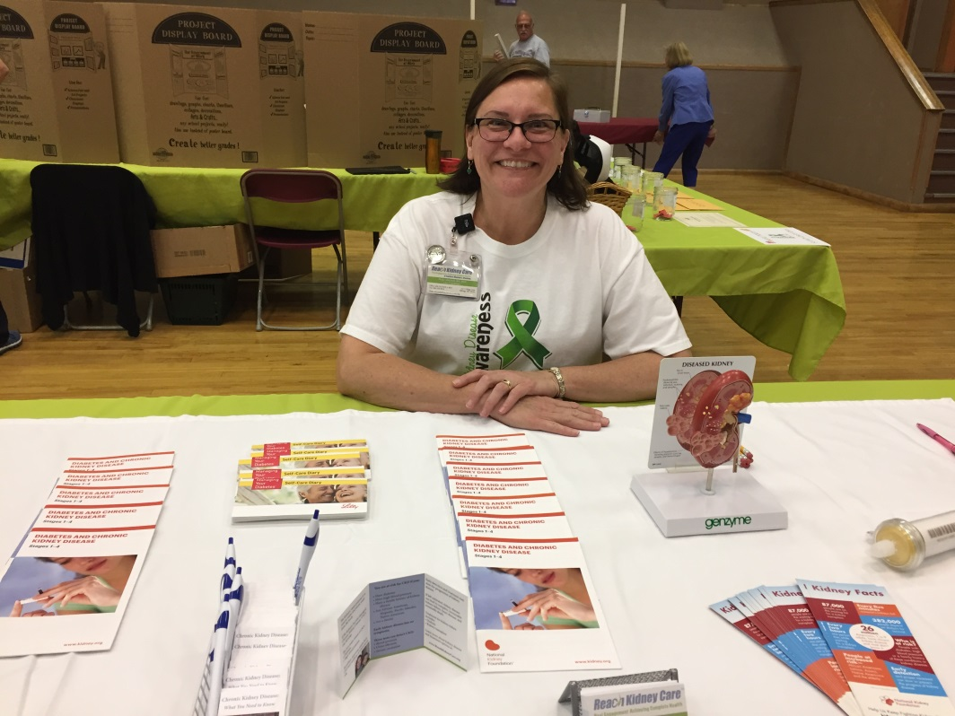
Community Education #4
Hope Mitchell, RN with DCI Reach Education
“Chronic Kidney Disease Care”

Slide 10
Community Education #5
Heritage Health Center
“Access to Affordable Healthcare”

Slide 11
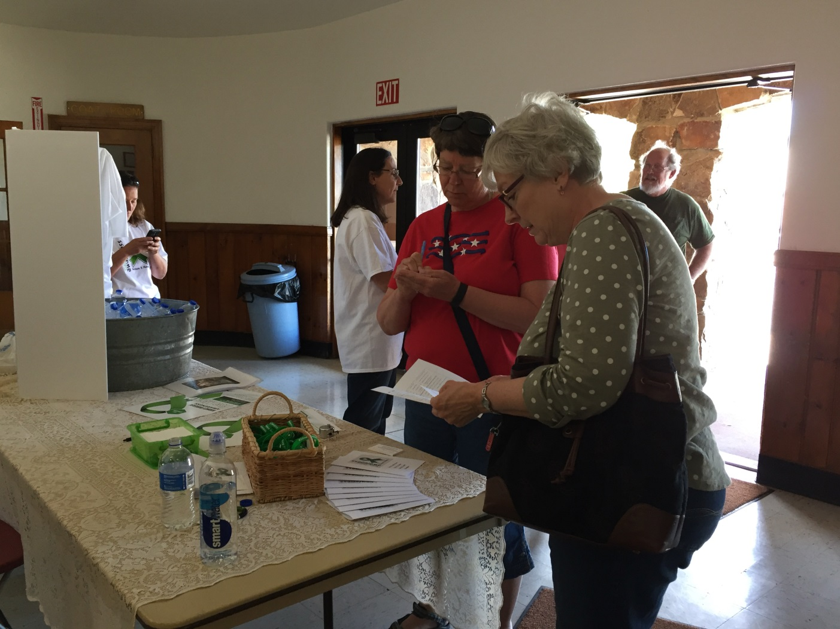
Participants were greeted at the door and given a brochure for the venders and a dance card to fill out when visiting education tables to win great door prizes for participating!!

Slide 12
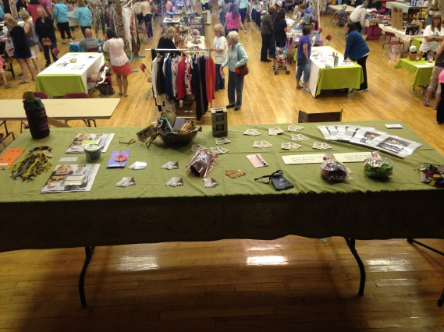
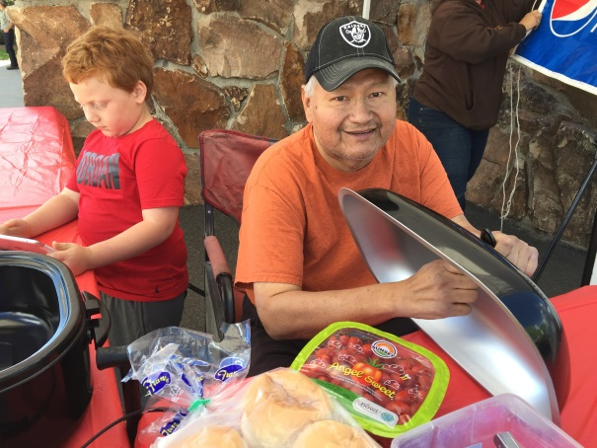
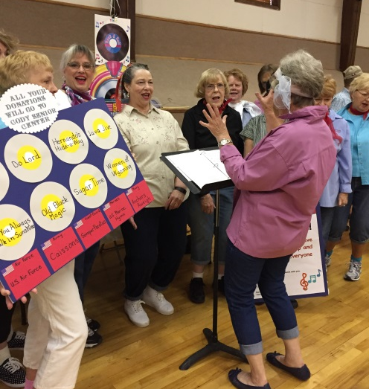
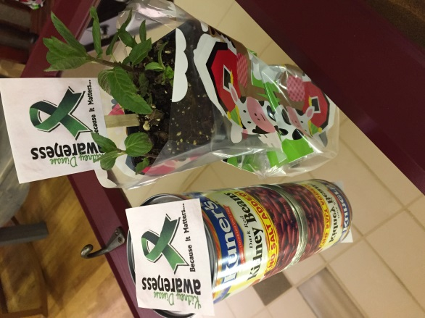
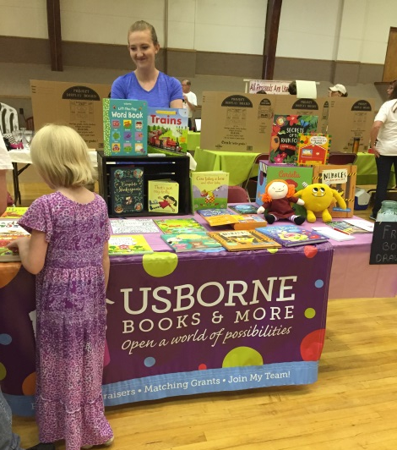
Door Prizes!!
Food!!
Live Jukebox!!
Special gifts for purchases from a dialysis nurse’s table!!
AND MUCH MORE!!!
Kids books!!

Slide 13
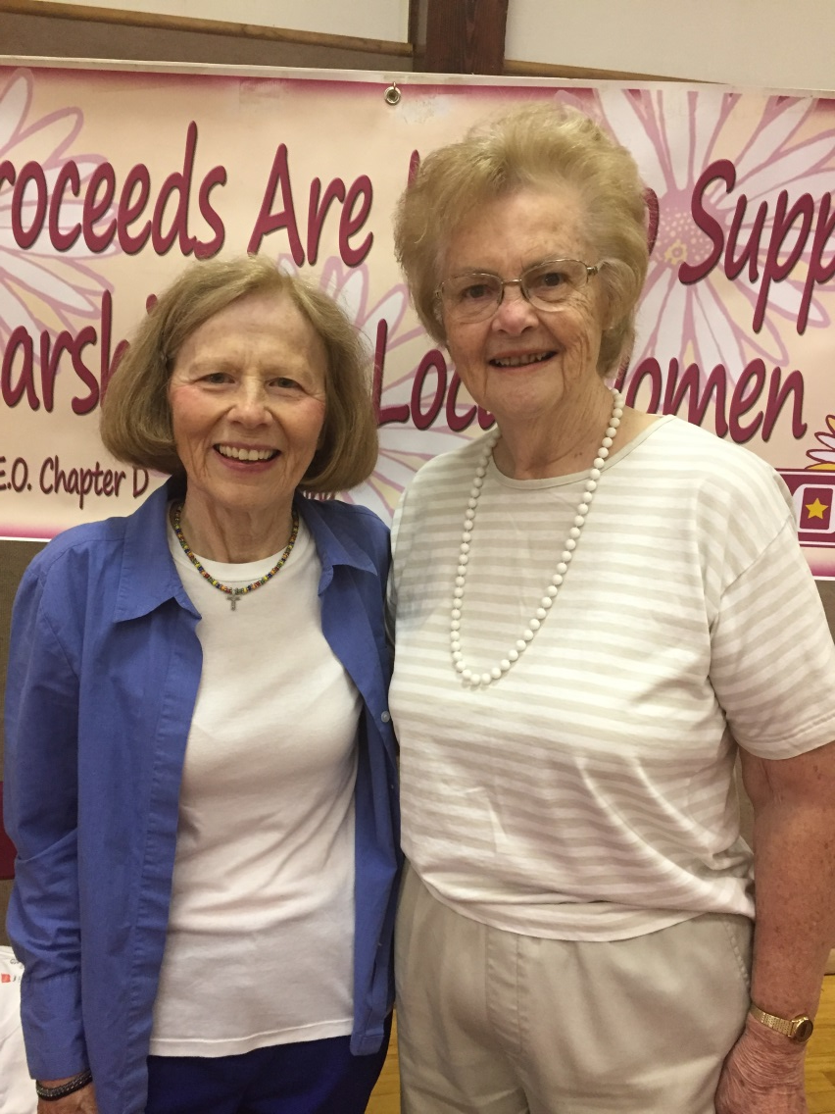
Visit from former Nurse Manager, Ruth Manley!!

Slide 14
Summary of our successful event:
We were able to raise a total of $1700 for the Cody Council on Aging (Cody Senior Center)
We had 33 tables occupied by vendors at our event.
We had 5 tables occupied by educators, with the following topics: Living Well on Dialysis (Clyde), Resources in our Community (Cody Senior Center), Chronic Kidney Disease Care (Hope with REACH), Eating Well/Kidney Disease Prevention (Liz), Access to Affordable Healthcare (Heritage Health Center).
We used a “dance card” format, where people became eligible for door prizes upon visiting our 5 educational tables. We had a total of 113 completed “dance cards” turned in during our 5 hour event. There were many other attendees who visited the tables but opted not to complete the “dance card” or enter for a door prize.
19 local businesses and 12 of our event vendors provided gift cards or merchandise donations which served as our door prizes. With the larger items, we created a raffle table, which brought in over $200 for the Cody Senior Center.
Our total expenditures for the event were $1514.13.

Slide 15
This was a great opportunity for all the staff at Big Horn Basin Regional Dialysis to give back to the community and to offer an educational event to get the word out about Chronic Kidney Disease. All the staff at Big Horn Dialysis participated in this event as well as many volunteers from Cody and Billings as well as family and friends!! Thank you DCI for funding this for us and allowing us to hold this event!!
Big Horn Dialysis Staff

